Slide 1
Version of 08-April-2012
Basics of H∞ Control
PART #1 the Loop-Shaping/Mixed Sensitivity Approach
(to Robust & Optimal Control)
Leonidas Dritsas PhD
ldri@otenet.gr
THANKS TO…
Prof. Kostas Kyriakopoulos (NTUA CSL)
Panos Marantos (PhD candidate)
Timestamp
08-Apr-12

Slide 2
Note
An H∞ “Crash Course” divides naturally into (at least) 3 parts:
Intro / Nominal Stability + Perform. / Freq. Domain (mainly) - Loopshaping – Mixed Sensitivity – Riccati Approach (DGKF’89)
ROBUST Stability + ROBUST Performance + “μ”-SSV
Linear Matrix Inequality (LMI), Bounded Real Lemma (BRL), Dissipativity, LMIreg, LPV + Gain Scheduling, Nonlinearities
THIS PRESENTATION IS AN ATTEMPT FOR PART #1 !

Slide 3
Contents
Intro – Classical Feedback Control
  (internal) stability + performance + robustness
SVD – Norms – {H∞, H₂ } spaces & concepts in Control – the Engineering Interpratation
(Nominal) Controller Design
  3.1 Loopshaping
  3.2 Mixed Sensitivity (1-DOF architecture)
  3.3 Generalized Plant + LFT
  3.4 WHAT do the 3 filters represent ?
  3.5 HOW do we select them? Fundamental Limitations in Control
MATLAB commands + examples (mixsyn/hinfsyn)
What’s next ? {“μ”-SSV, LMIs, BRL, dissipativity, LMIreg, LPV + Gain Scheduling, Nonlinearities}

Slide 4

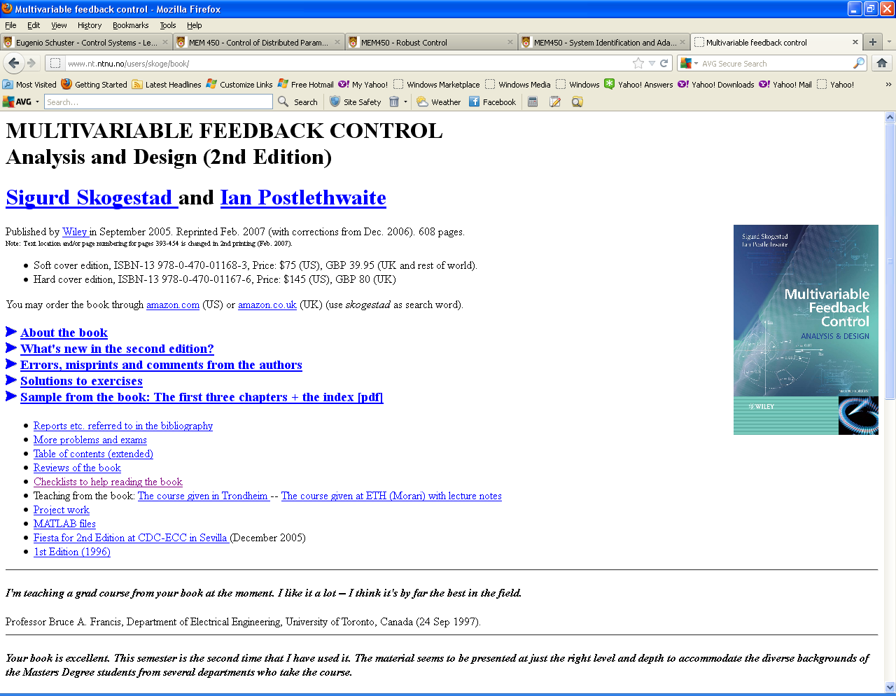
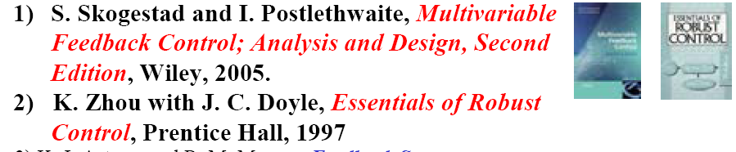
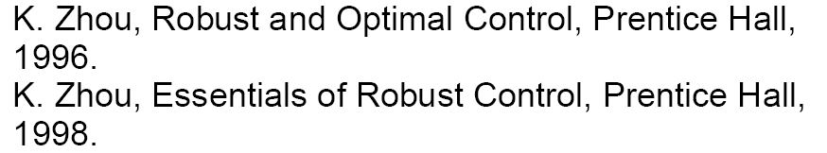
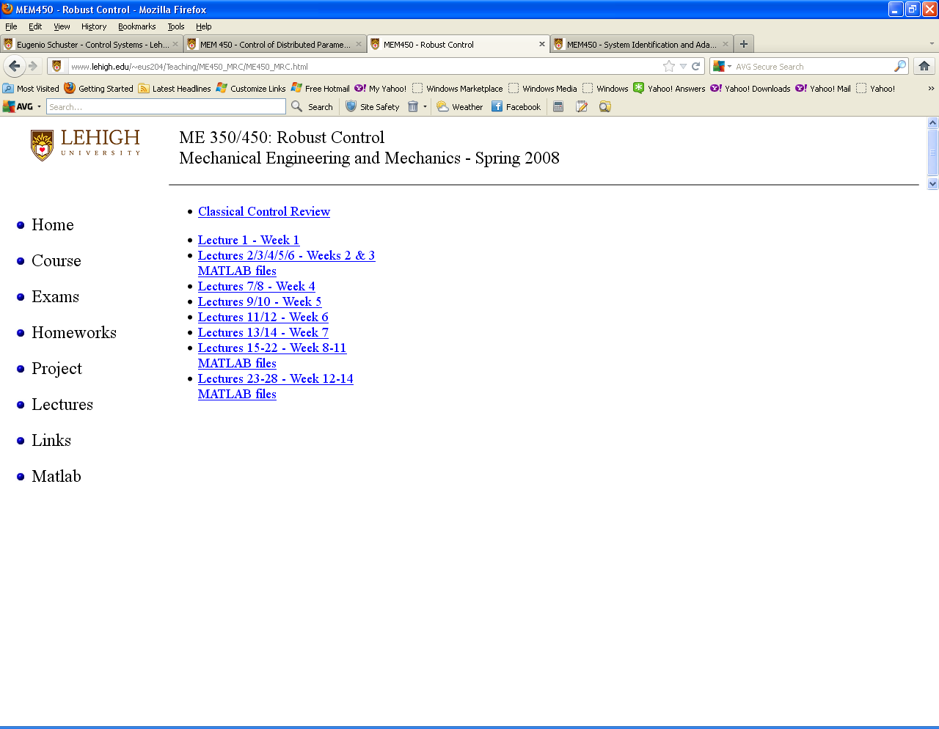
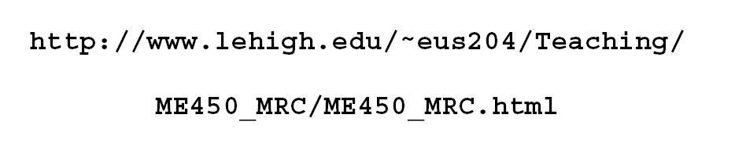
http://www.nt.ntnu.no/users/skoge/book/

Slide 5
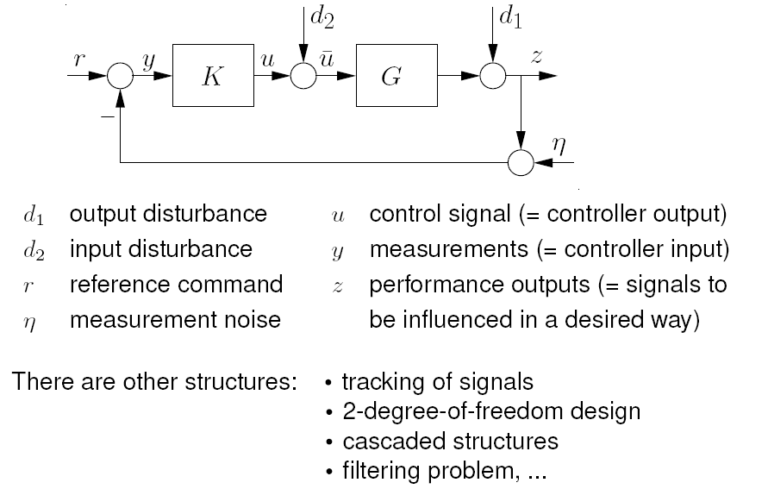
The Classical (1-DOF) Control Loop
Notes:
Allgower rc_part3_handout_2up Standard problem, LFTs

Slide 6
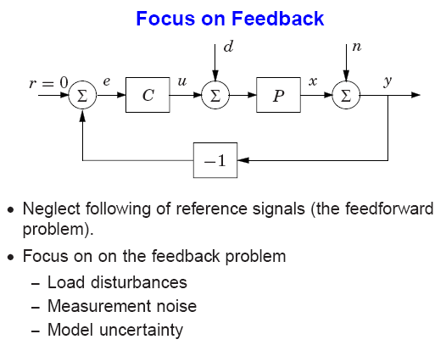
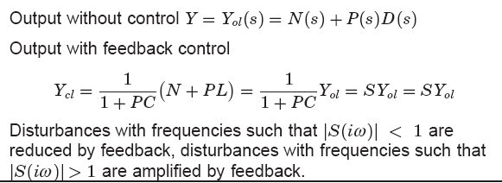
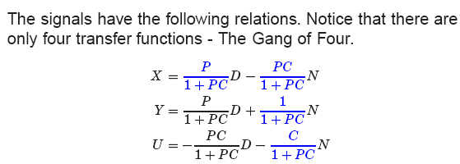
The “Gang of Four”
The “Gang of Four”: For internal stability must “check-stab” Four TFs
Notes:
21b KJA CTRL SYSTEM DESIGN (Slides) - lecture06 The Basic Feedback Loop

Slide 7
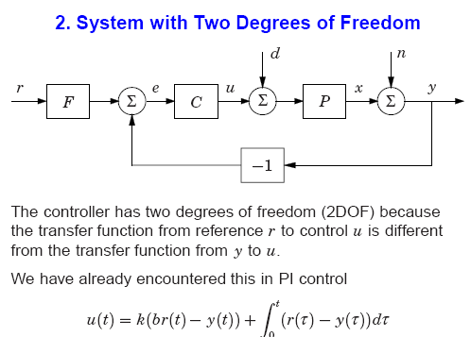
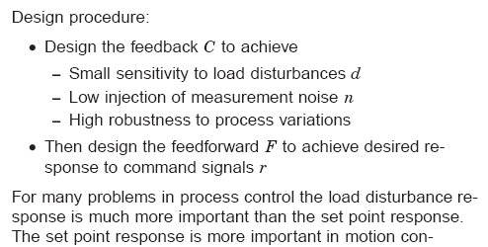
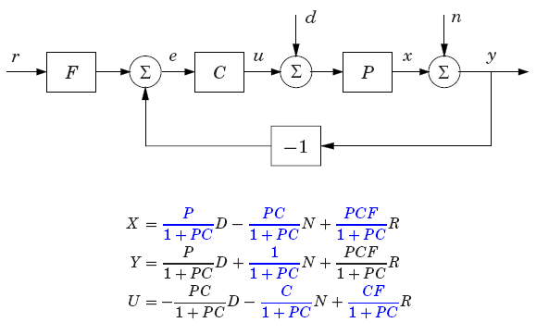
Two Degrees of Freedom
Use a “prefilter” to meet both
regulator and tracking performance
The Gang of Six
For internal stability must “check-stab” SIX TFs
Notes:
21b KJA CTRL SYSTEM DESIGN (Slides) - lecture06 The Basic Feedback Loop

Slide 8
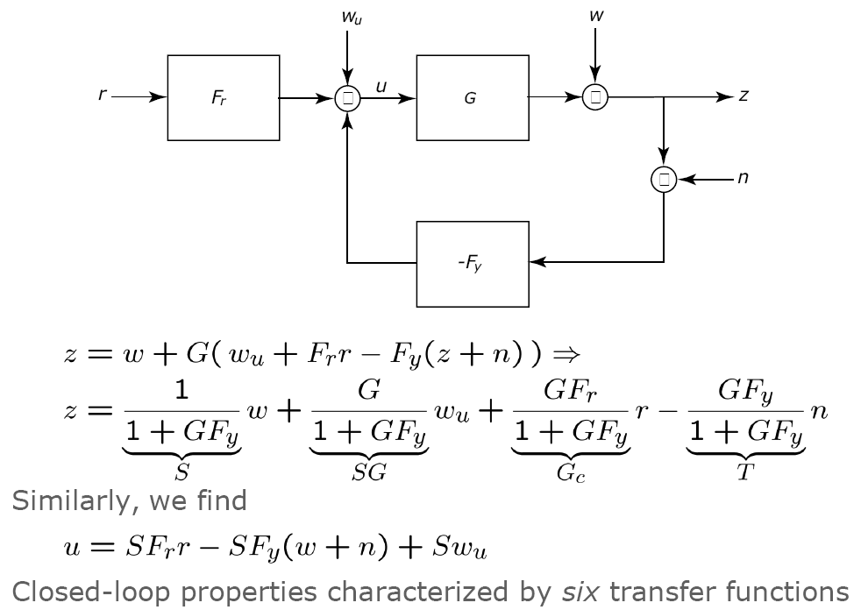
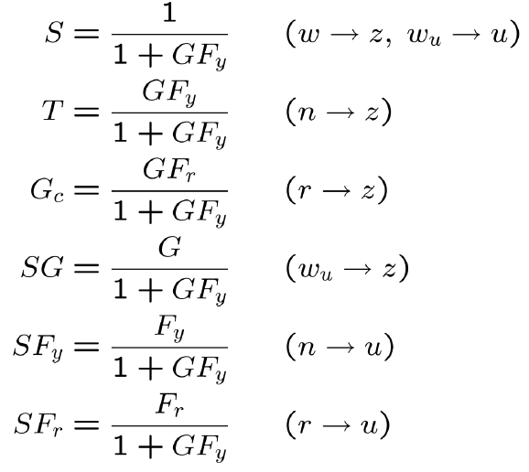
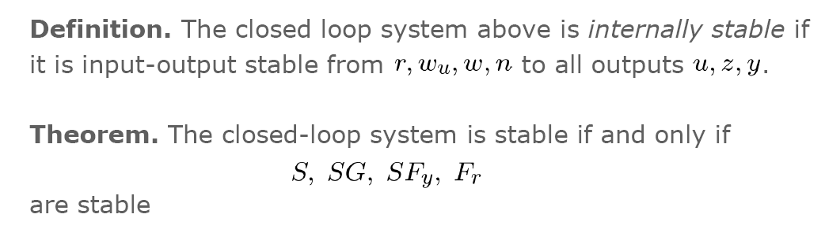
Two Degrees of Freedom
Alternative config.

Slide 9
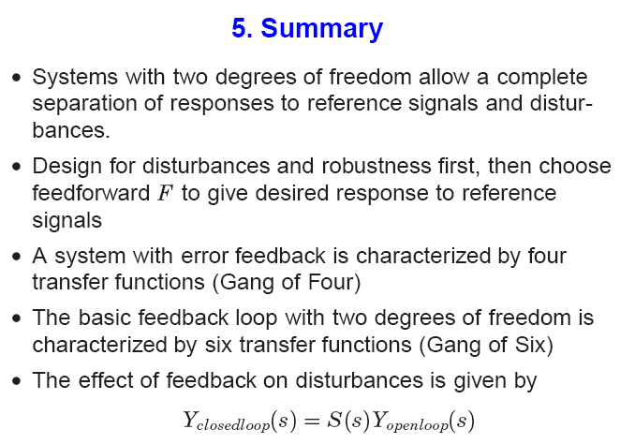
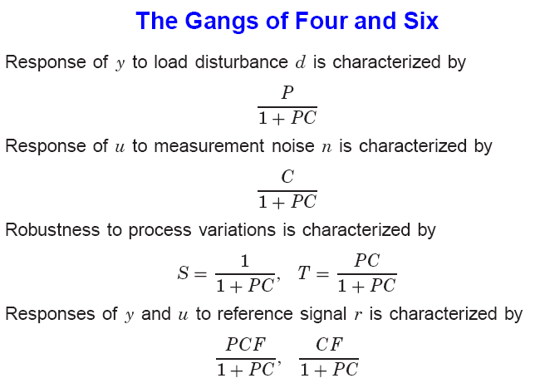
Notes:
21b KJA CTRL SYSTEM DESIGN (Slides) - lecture06 The Basic Feedback Loop

Slide 10
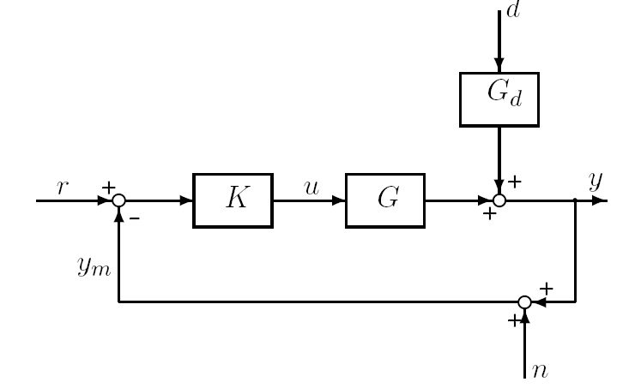
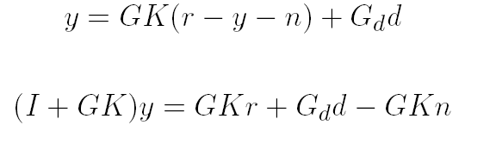
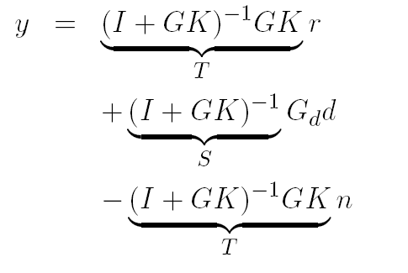
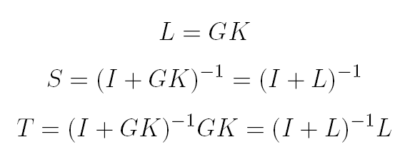



1-DOF feedback control system Closed-loop response
Control error:
Plant input:
Notes:
lecture02 Classical Feedback Control

Slide 11
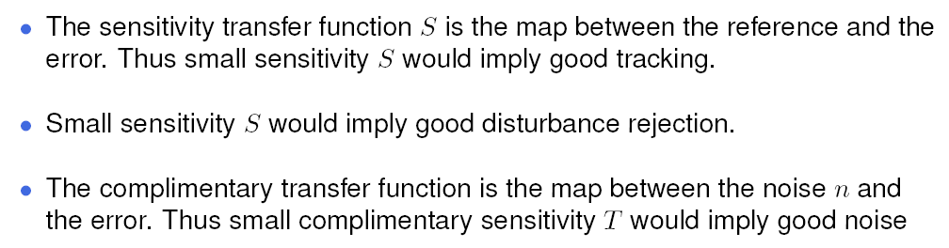
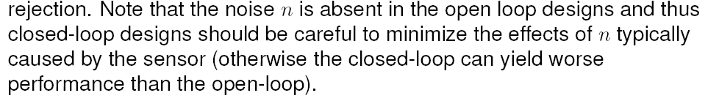
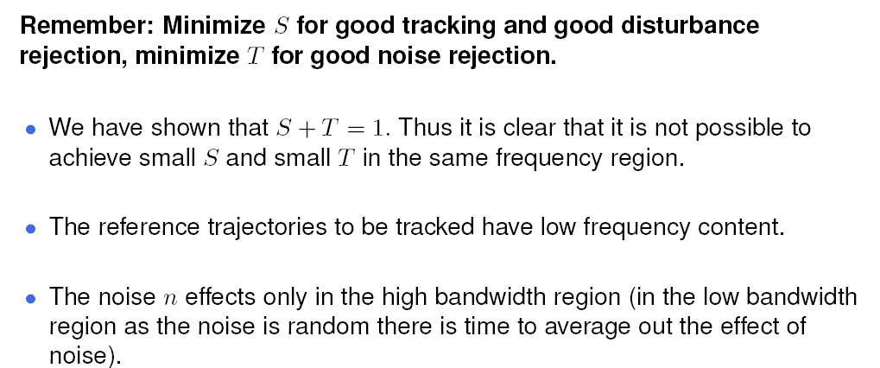
Design TRADE OFFs = “CANNOT HAVE IT ALL”

Slide 12
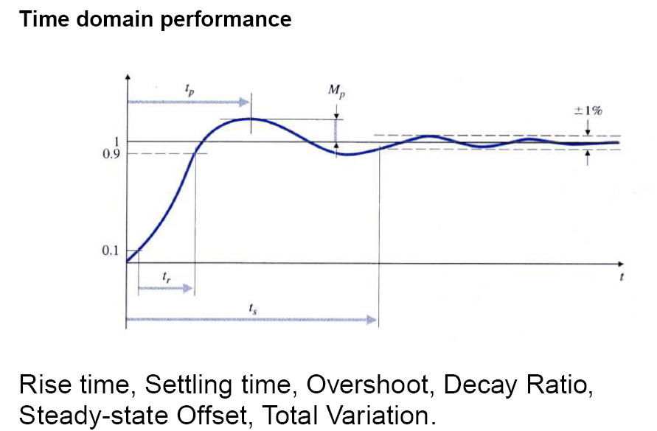
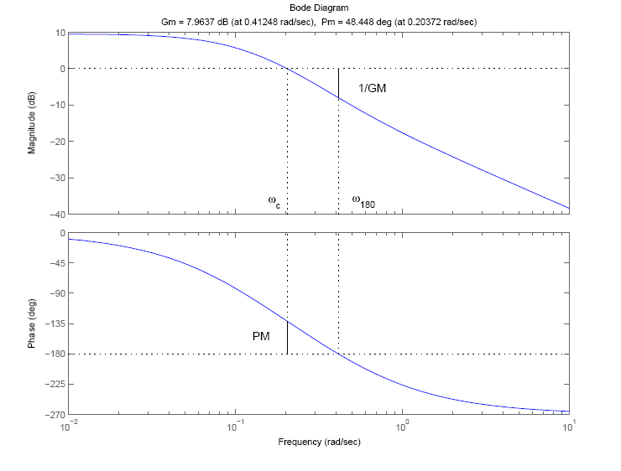
Closed-loop Performance
Closed-loop Robustness
Bode / Nyquist plots of L(jω)

Slide 13
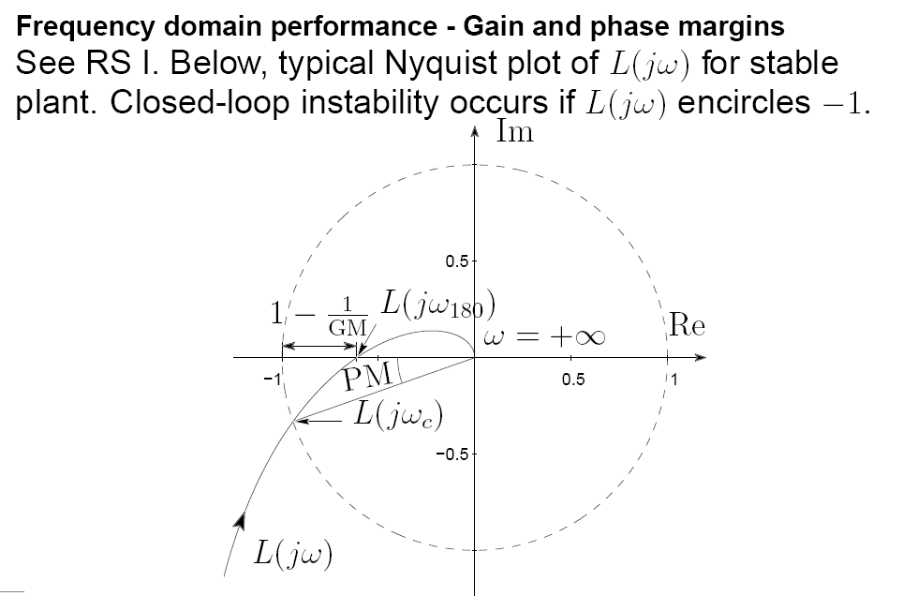
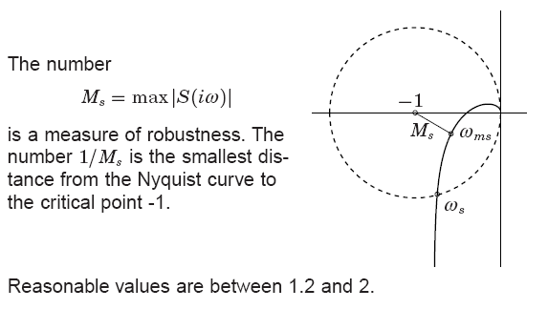
Max. (Peak) Sensitivity Ms

Slide 14
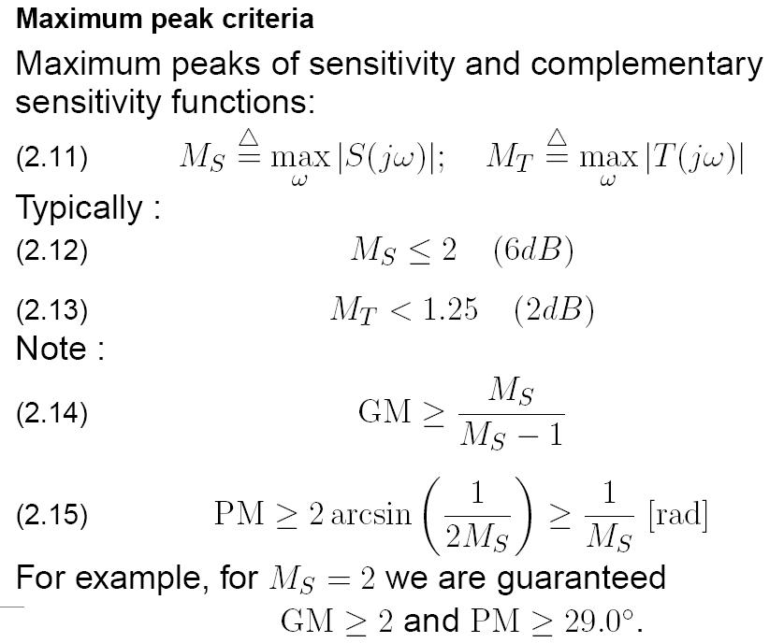

Slide 15
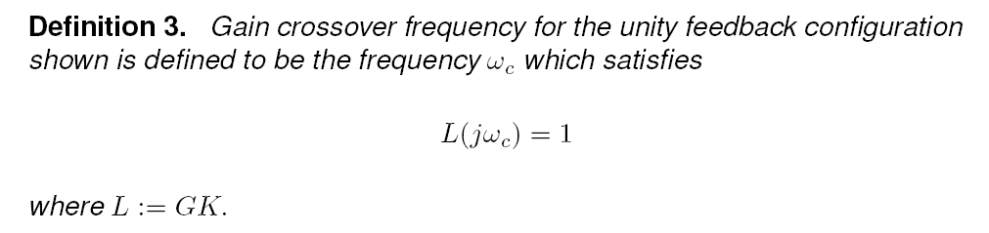
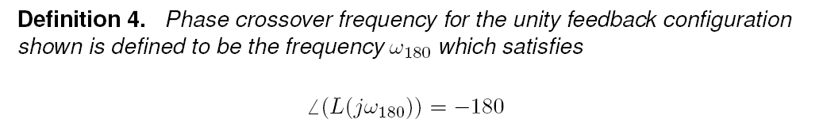
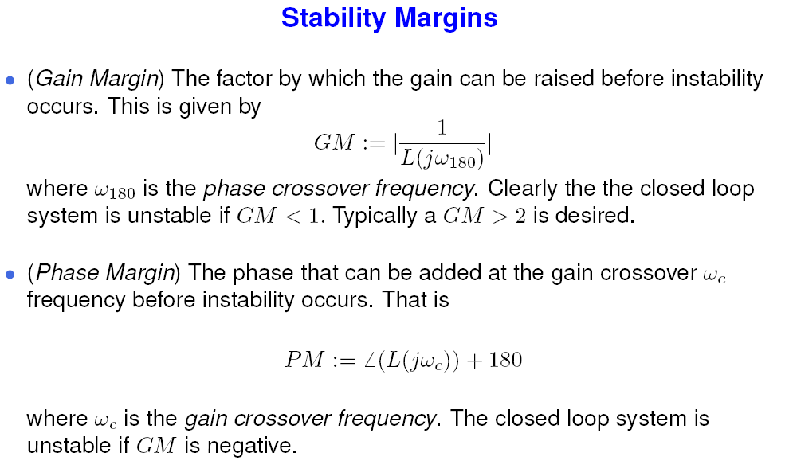

Slide 16
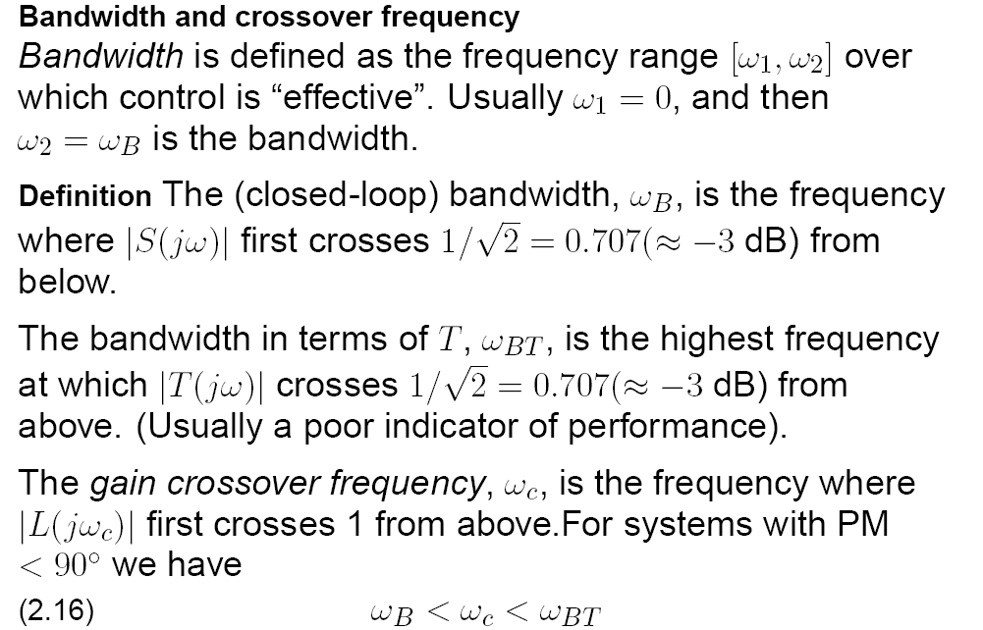

Slide 17
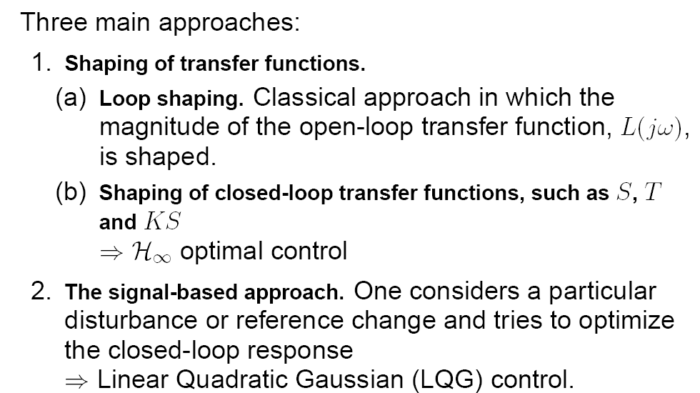
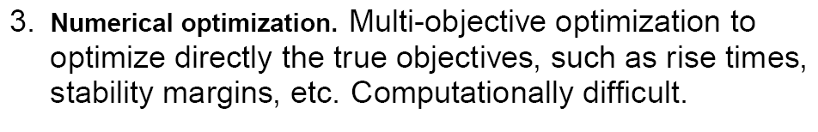
Controller design = TRADE OFFs = “CANNOT HAVE IT ALL”

Slide 18
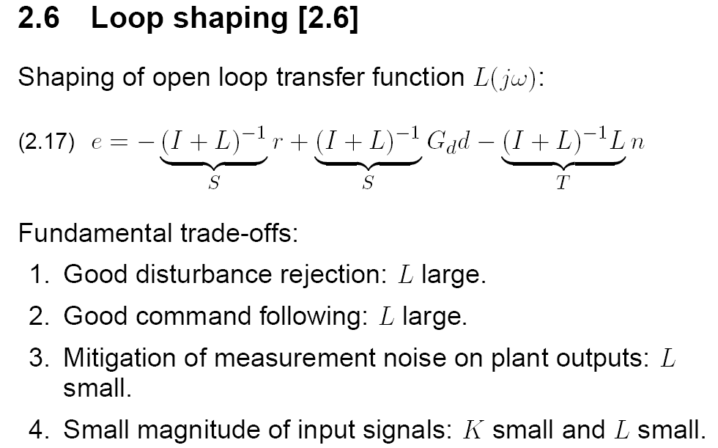

Slide 19
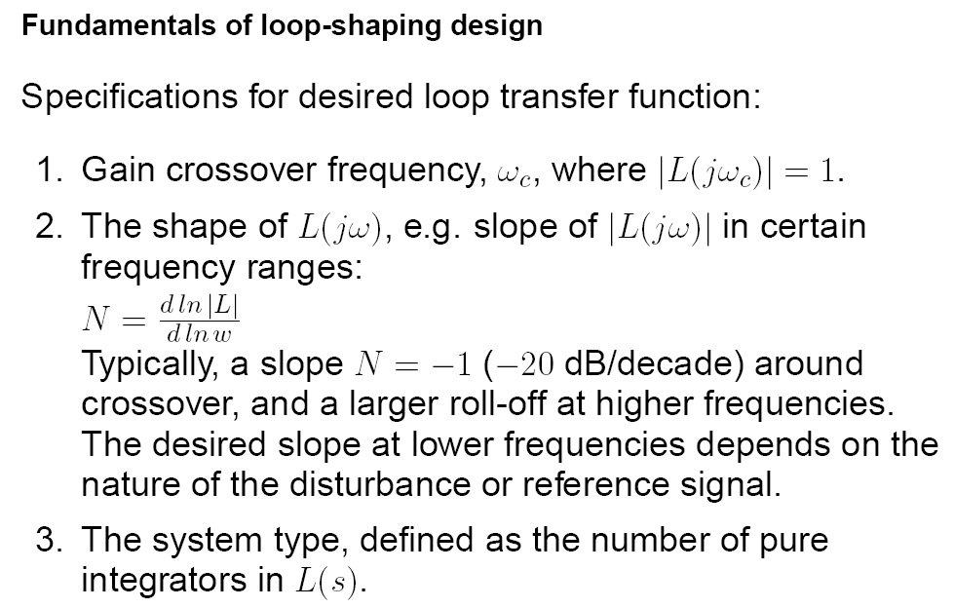
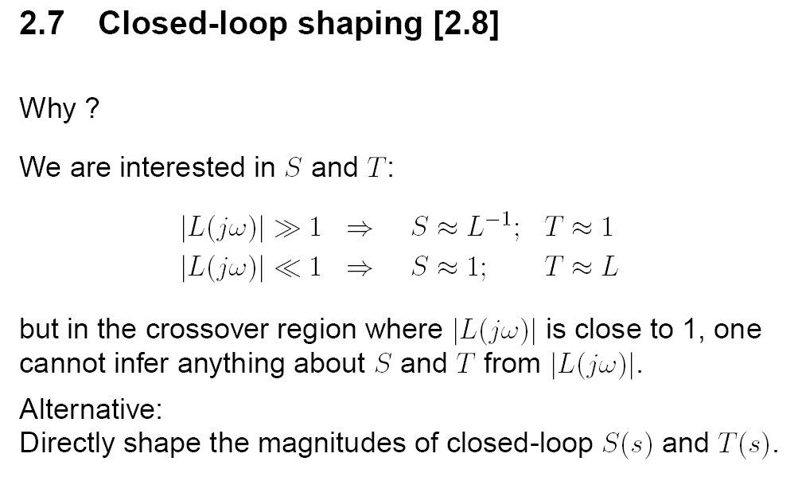

Slide 20
Contents
Intro – Classical Feedback Control - (internal) stability + performance + robustness
SVD – Norms – {H∞, H₂ } spaces & concepts in Control – the Engineering Interpratation
(Nominal) Controller Design
  3.1 Loopshaping
  3.2 Mixed Sensitivity (1-DOF architecture)
  3.3 Generalized Plant + LFT
  3.4 WHAT do the 3 filters represent ?
  3.5 HOW do we select them? Fundamental Limitations in Control
MATLAB commands + examples (mixsyn/hinfsyn)
What’s next ? {“μ”-SSV, LMIs, BRL, dissipativity, LMIreg, LPV + Gain Scheduling, Nonlinearities}

Slide 21
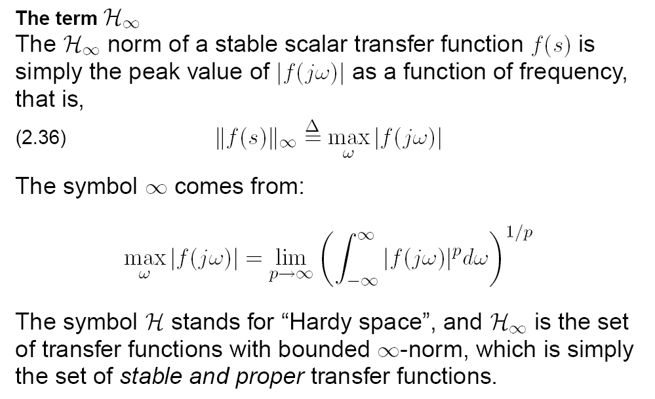

Slide 22
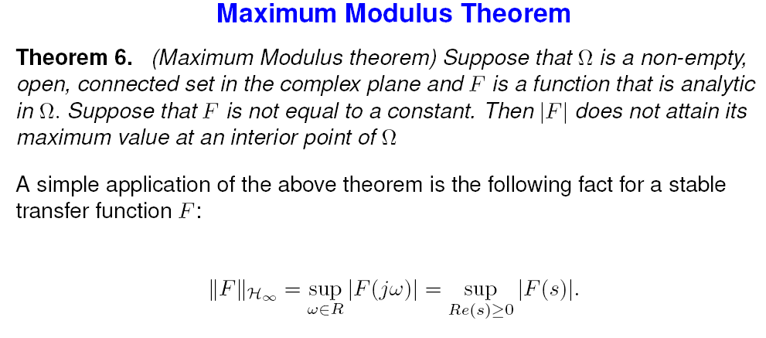
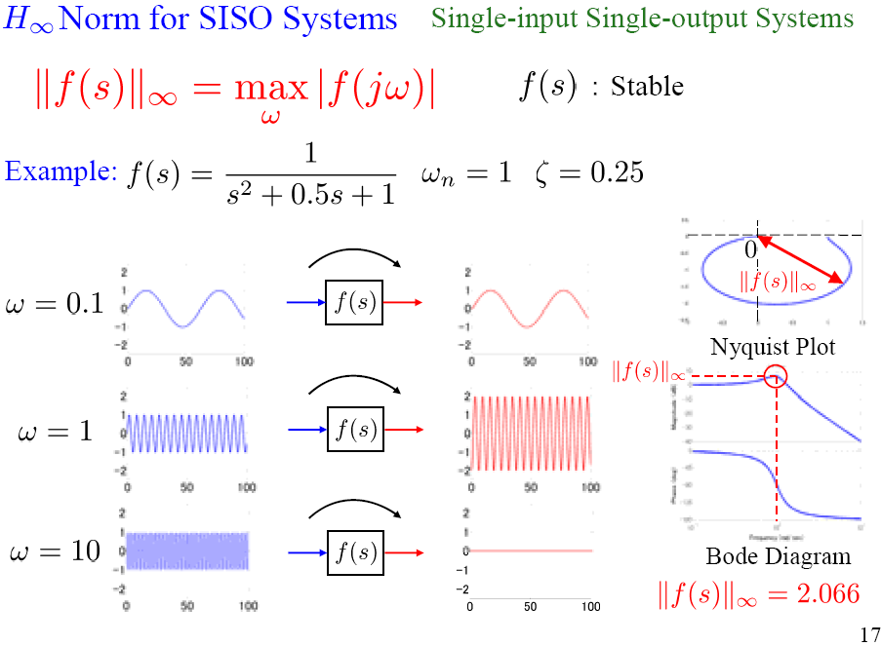
Signal & System Norms

Slide 23
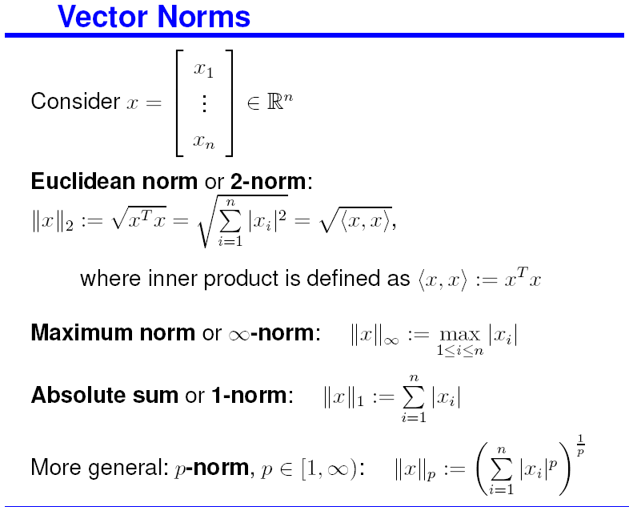
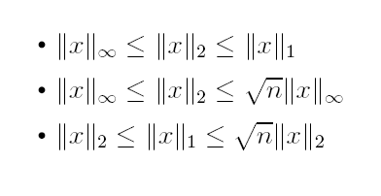
Vector & Matrix Norm(s)
Notes:
Allgower rc_part2_handout_2up Math background

Slide 24
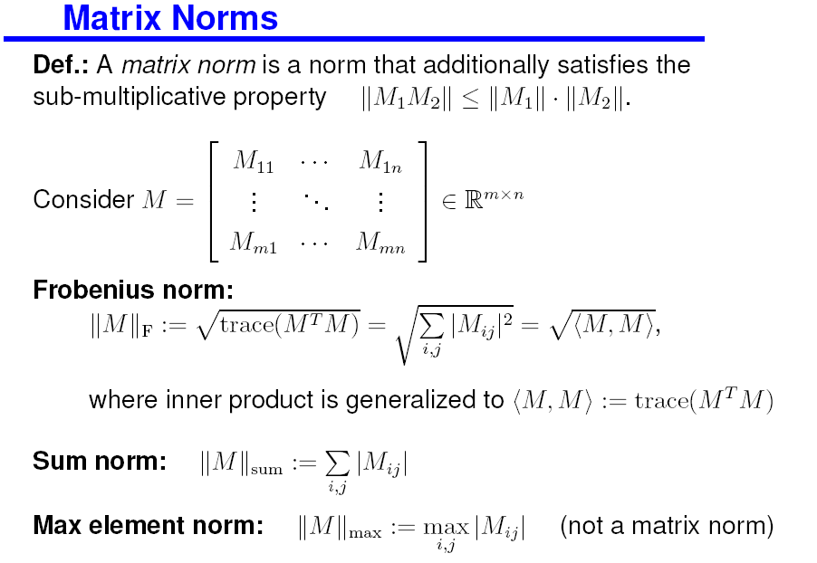
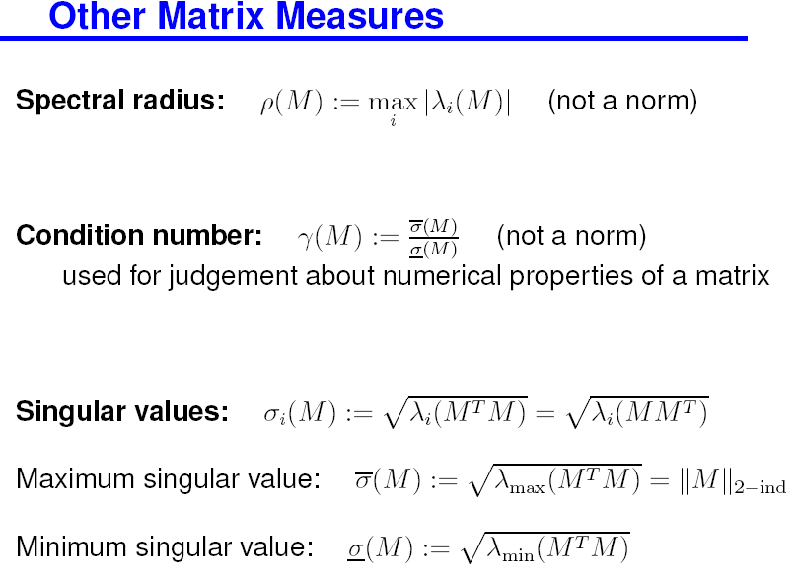
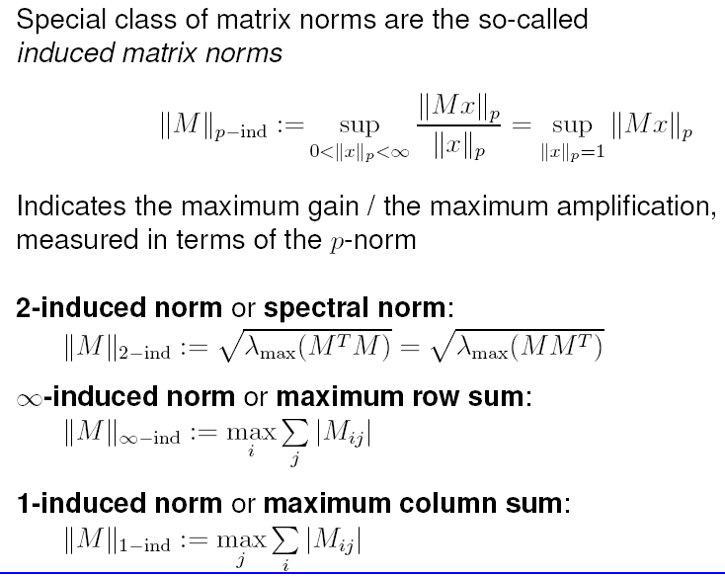
(Induced) Matrix Norms
Vector & Matrix Norm(s)

Slide 25
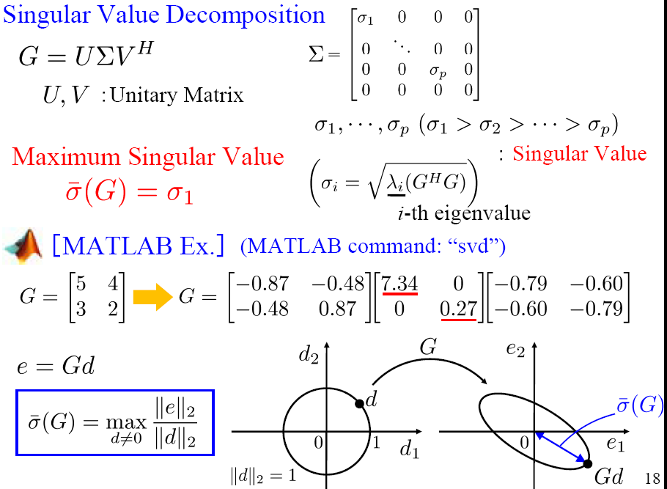

Slide 26
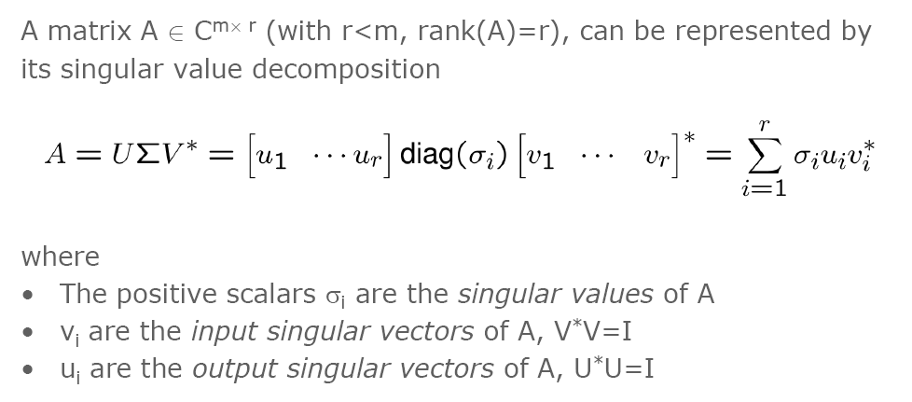
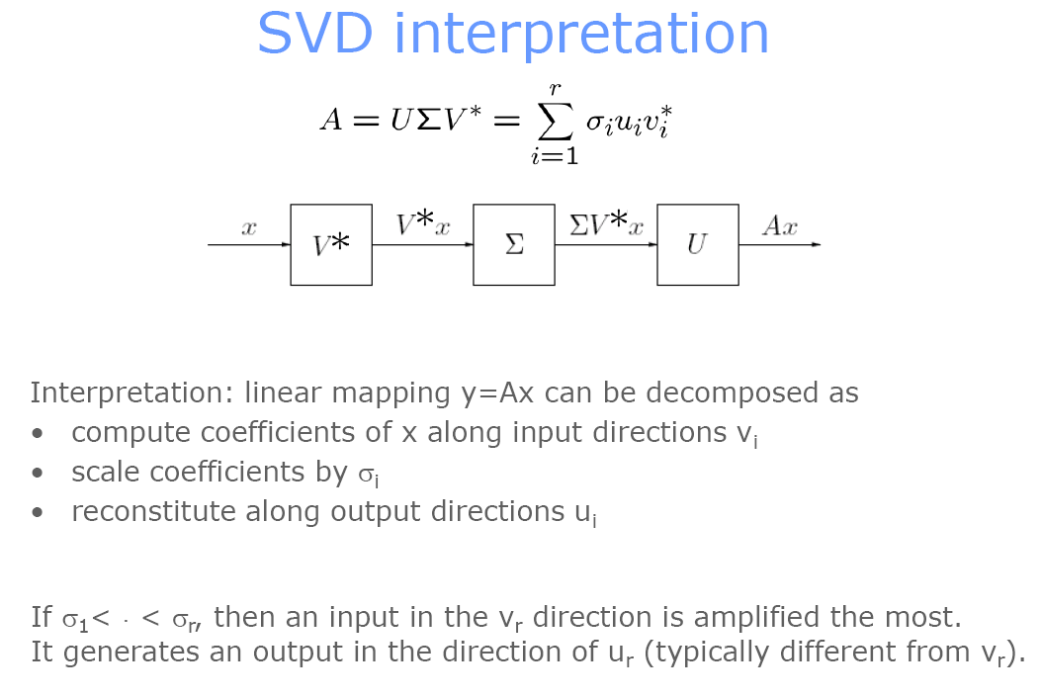
Notes:
06f KTH EL2520 Lectures slides and Exercise lec06 Multivariable systems

Slide 27
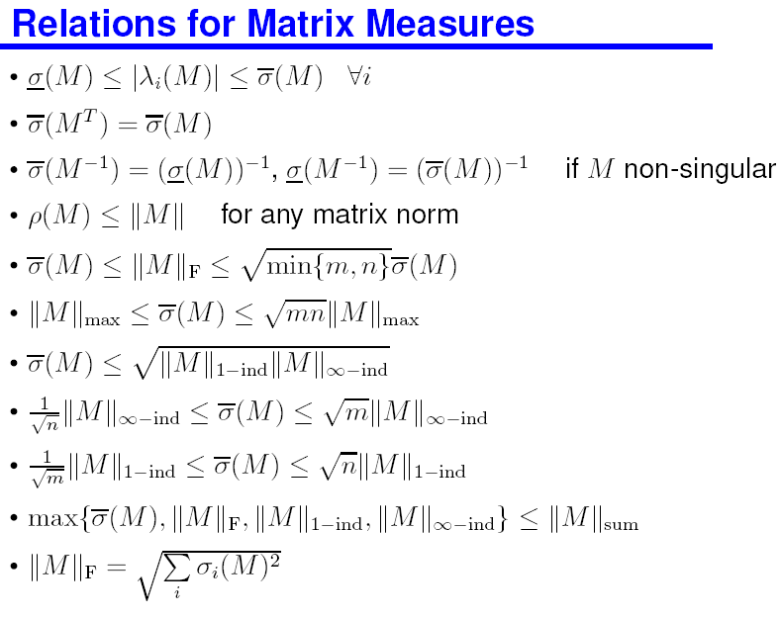


Vector & Matrix Norm(s)

Slide 28


Signal & System Norms

Slide 29

Signal & System Norms

Slide 30


Slide 31


Signal & System Norms

Slide 32



A paradigm shift: Generic control configuration (John Doyle)
The concept of Generalized Plant Will be explained shortly

Slide 33

Notes:
Lecture11 Hinf control (Scherer 159 pages)

Slide 34
Contents
Intro – Classical Feedback Control - (internal) stability + performance + robustness
SVD – Norms – {H∞, H₂ } spaces & concepts in Control – the Engineering Interpratation
(Nominal) Controller Design
  3.1 Loopshaping
  3.2 Mixed Sensitivity (1-DOF architecture)
  3.3 Generalized Plant + LFT
  3.4 WHAT do the 3 filters represent ?
  3.5 HOW do we select them? Fundamental Limitations in Control
MATLAB commands + examples (mixsyn/hinfsyn)
What’s next ? {“μ”-SSV, LMIs, BRL, dissipativity, LMIreg, LPV + Gain Scheduling, Nonlinearities}

Slide 35


Recall Classical Loop Shaping
Notes:
06f KTH EL2520 Lectures slides and Exercise

Slide 36


Recall Classical Loop Shaping
Notes:
06f KTH EL2520 Lectures slides and Exercise -- lec05_new Classical loop shaping

Slide 37


Recall Classical Loop Shaping
Notes:
06f KTH EL2520 Lectures slides and Exercise -- lec05_new Classical loop shaping

Slide 38



Recall Classical Loop Shaping - Relation to stability margins
Notes:
06f KTH EL2520 Lectures slides and Exercise -- lec05_new Classical loop shaping

Slide 39


Notes:
15b Robust Slides Tokyo Inst of Technology - SC_03rd Loop Shaping

Slide 40


Notes:
15b Robust Slides Tokyo Inst of Technology - SC_03rd Loop Shaping

Slide 41


Notes:
15b Robust Slides Tokyo Inst of Technology - SC_03rd Loop Shaping

Slide 42


Notes:
15b Robust Slides Tokyo Inst of Technology - SC_03rd Loop Shaping

Slide 43



Slide 45
Contents
Intro – Classical Feedback Control - (internal) stability + performance + robustness
SVD – Norms – {H∞, H₂ } spaces & concepts in Control – the Engineering Interpratation
(Nominal) Controller Design
  3.1 Loopshaping
  3.2 Mixed Sensitivity (1-DOF architecture)
  3.3 Generalized Plant + LFT
  3.4 WHAT do the 3 filters represent ?
  3.5 HOW do we select them? Fundamental Limitations in Control
MATLAB commands + examples (mixsyn/hinfsyn)
What’s next ? {“μ”-SSV, LMIs, BRL, dissipativity, LMIreg, LPV + Gain Scheduling, Nonlinearities}

Slide 46


Notes:
Lecture11 Hinf control (Scherer 159 pages)

Slide 47



Notes:
Lecture11 Hinf control (Scherer 159 pages)

Slide 48


Slide 49


Slide 50



Slide 51


Slide 52


Slide 53


Slide 54


Slide 55


Slide 56


Slide 57


Loop gain specifications
S as a function of L
Notes:
06f KTH EL2520 Lectures slides and Exercise -- lec05_new Classical loop shaping

Slide 58


T as a function of L
Relation to stability margins
Notes:
06f KTH EL2520 Lectures slides and Exercise -- lec05_new Classical loop shaping

Slide 59



Probably the most important slide
(for Design purposes)
Same as slide #44

Slide 60


Probably the most important slide
(for Design purposes)

Slide 61

Notes:
06f KTH EL2520 Lectures slides and Exercise lec07_new Multivariable loop shaping

Slide 63
Contents
Intro – Classical Feedback Control
  (internal) stability + performance + robustness
SVD – Norms – H∞ - H₂ - Engineering Interpr.
(Nominal) Controller Design
  Loopshaping – Mixed Sensitivity (1-DOF architecture)
  Generalized Plant + LFT
  WHAT do the 3 filters represent ?
  HOW do we select the 3 filters ? Fundamental Limitations
MATLAB commands + examples (mixsyn/hinfsyn)

Slide 64






Slide 65


Separate Lecture on
Robustness

Slide 66

The SMALL GAIN Theorem

Slide 67



Robustness Interpretation of W1, W2, W3 filters

Slide 68



Robustness Interpretation of W1, W2, W3 filters

Slide 69



Generalized Plant + LFT

Slide 70

Generalized Plant + LFT

Slide 71

Generalized Plant + LFT

Slide 72

Generalized Plant + LFT
Notes:
Salapaka 64

Slide 73



Generalized Plant for the Classical Control Loop
Notes:
Allgower rc_part3_handout_2up Standard problem, LFTs

Slide 74

Standard Problem: P-K-Structure + LFT = Linear Fractional Transformations (Upper & Lower)

Slide 75


LFT = Linear Fractional Transformations (Upper & Lower)

Slide 76
Contents
Intro – Classical Feedback Control - (internal) stability + performance + robustness
SVD – Norms – {H∞, H₂ } spaces & concepts in Control – the Engineering Interpratation
(Nominal) Controller Design
  3.1 Loopshaping
  3.2 Mixed Sensitivity (1-DOF architecture)
  3.3 Generalized Plant + LFT
  3.4 WHAT do the 3 filters represent ?
  3.5 HOW do we select them? Fundamental Limitations in Control
MATLAB commands + examples (mixsyn/hinfsyn)
What’s next ? {“μ”-SSV, LMIs, BRL, dissipativity, LMIreg, LPV + Gain Scheduling, Nonlinearities}

Slide 77

Fundamental Performance Limitations
reflected in filter limitations
1. Perfect control & plant inversion

Slide 78



Fundamental Performance Limitations
reflected in filter limitations
2 Constraints on S and T
3 The waterbed effects (BODE sensitivity integrals 1945)
4 Interpolation constraints from internal stability

Slide 79

Fundamental Performance Limitations
reflected in filter limitations
5 Sensitivity peaks - Maximum modulus Principle.

Slide 80

Fundamental Performance Limitations
reflected in filter limitations

Slide 81

Fundamental Performance Limitations
reflected in filter limitations

Slide 82




Fundamental Performance Limitations
reflected in filter limitations

Slide 83



Fundamental Performance Limitations
reflected in filter limitations
Limitations imposed by RHP-poles

Slide 84

Limiting factors
Notes:
06f KTH EL2520 Lectures slides and Exercise -- lec05_new Classical loop shaping

Slide 85
Contents
Intro – Classical Feedback Control - (internal) stability + performance + robustness
SVD – Norms – {H∞, H₂ } spaces & concepts in Control – the Engineering Interpratation
(Nominal) Controller Design
  3.1 Loopshaping
  3.2 Mixed Sensitivity (1-DOF architecture)
  3.3 Generalized Plant + LFT
  3.4 WHAT do the 3 filters represent ?
  3.5 HOW do we select them? Fundamental Limitations in Control
MATLAB commands + examples (mixsyn/hinfsyn)
What’s next ? {“μ”-SSV, LMIs, BRL, dissipativity, LMIreg, LPV + Gain Scheduling, Nonlinearities}

Slide 86


Slide 87




hinfsyn

Slide 88


hinfsyn

Slide 89



mixsyn

Slide 90


mixsyn

Slide 91



Slide 92
Contents
Intro – Classical Feedback Control - (internal) stability + performance + robustness
SVD – Norms – {H∞, H₂ } spaces & concepts in Control – the Engineering Interpratation
(Nominal) Controller Design
  3.1 Loopshaping
  3.2 Mixed Sensitivity (1-DOF architecture)
  3.3 Generalized Plant + LFT
  3.4 WHAT do the 3 filters represent ?
  3.5 HOW do we select them? Fundamental Limitations in Control
MATLAB commands + examples (mixsyn/hinfsyn)
What’s next ? “μ”-SSV, LMIs, BRL, dissipativity, “LMIreg”, LPV + Gain Scheduling, Handling Nonlinearities

Slide 93
THE END
THANK YOU FOR YOUR ATTENTION
THANKS TO…
Prof. Kostas Kyriakopoulos (NTUA CSL)
Panos Marantos (PhD candidate)

Slide 96
Contents
Intro – Classical Feedback Control - (internal) stability + performance + robustness
SVD – Norms – {H∞, H₂ } spaces & concepts in Control – the Engineering Interpratation
(Nominal) Controller Design
  3.1 Loopshaping
  3.2 Mixed Sensitivity (1-DOF architecture)
  3.3 Generalized Plant + LFT
  3.4 WHAT do the 3 filters represent ?
  3.5 HOW do we select them? Fundamental Limitations in Control
MATLAB commands + examples (mixsyn/hinfsyn)
What’s next ? {“μ”-SSV, LMIs, BRL, dissipativity, LMIreg, LPV + Gain Scheduling, Nonlinearities}

Slide 97
Contents
Intro – Classical Feedback Control
  (internal) stability + performance + robustness
SVD – Norms – H∞ - H₂ - Engineering Interpr.
(Nominal) Controller Design
  Loopshaping – Mixed Sensitivity (1-DOF architecture)
  WHAT do the 3 filters represent ?
  HOW do we select the 3 filters ? Fundamental Limitations
MATLAB commands + examples (mixsyn/hinfsyn)
What’s next ? “μ”-SSV, LMIs, BRL, dissipativity, LMIreg, LPV + Gain Scheduling, Nonlinearities

Slide 98


Slide 100
Modeling for “small” (τ^{k} < h) and “Long” delays

